Slide 1
FACIAL PAYMENT TECHNOLOGY
PRESENTED BY
JASMINE MONOLISHA A
JAYASEELI BERACHAH M
(AI&DS – I YEAR)

Slide 2
ABSTRACT
It’s a technology that allows people to pay for goods and services through facial recognition.
Face recognition technology is a fast processing nature and it doesn’t need any contact with users. Without current identity verification methods, users must remember passwords, present I.D. cards, and other inconveniences which will not be needed in face payment.
WE WILL LOOK IN DETAIL ABOUT THIS TOPIC

Slide 3
OBJECTIVES
facial-recognition payment (FRP, or Scan the face to pay) has gained popularity in China as a new digital-payment method
Facial-recognition payment is convenient.

Slide 4
INTRODUCTION
Facial recognition payment is a new way of paying money in malls, and railway subways.
when you want to make a payment, you pose in front of a special camera or screen. It scans your face and compares its features with the image in the system.

Slide 5
FACE PAYMENT
This wallet-free reality is largely due to QR-code scanning: people scan the QR code in a shop and pay the amount of the order on their phones. Facial recognition takes this process a step further — you don’t even need your phone, just your face.

Slide 6
One of the latest innovations in digital payments is facial recognition.
POS systems that use facial recognition technology can verify customers’ identities and authorize payments quickly and easily.

Slide 7
PROCEDURE
First, you link an image of your face to a digital payment system or a bank account.
And then, when you want to make a payment, you pose in front of a special camera or screen. It scans your face and compares its features with the image in the system.
Once it confirms that it’s the same person, money is withdrawn from your account and your payment is completed.

Slide 8
DIFFERENCE
PAYMENT METHODS | DEVICE REQUIREMENTS | SOFTWARE REQUIREMENTS | TIME COST
Apple Pay or Android Pay | A phone that supports facial recognition | Credit/debit card preset in Apple Pay | Within 15s
QR-code scanning | A smartphone with a camera | An Ali Pay/WeChat account and an associated bank account | 30s – 1min
Facial recognition | None (well, a face) | An Ali Pay/WeChat account and an associated bank account | 10 – 15s (For frequent users, it could be less than 10 seconds)

Slide 9
At the moment, China is leading the charge when it comes to the use of facial recognition payment.
There are two main facial recognition payment services in the country: Alipay’s Dragonfly and WeChat Pay’s Frog Pro. Both are currently available in China.

Slide 10
Are there any concerns?
A common concern with facial recognition technology is that someone could try to trick the system by stealing another person’s photo and holding it up against the camera or screen. However, that’s something that the makers of this technology seem to have anticipated.
This should at least instil some confidence in those who are worried about the security of the service.

Slide 11
FUTURE SCOPE FOR FACIAL PAYMENT
The future looks promising for facial recognition payment. But as to whether it will eventually topple and replace other payment systems, no one truly knows.
While it’s a good alternative to other payment methods like credit cards, there are some people who may never accept facial recognition payment because of privacy concerns.
There is also the issue of government acceptance.

Slide 12
MISTAKES DID IN FACE PAYMENT

Slide 13
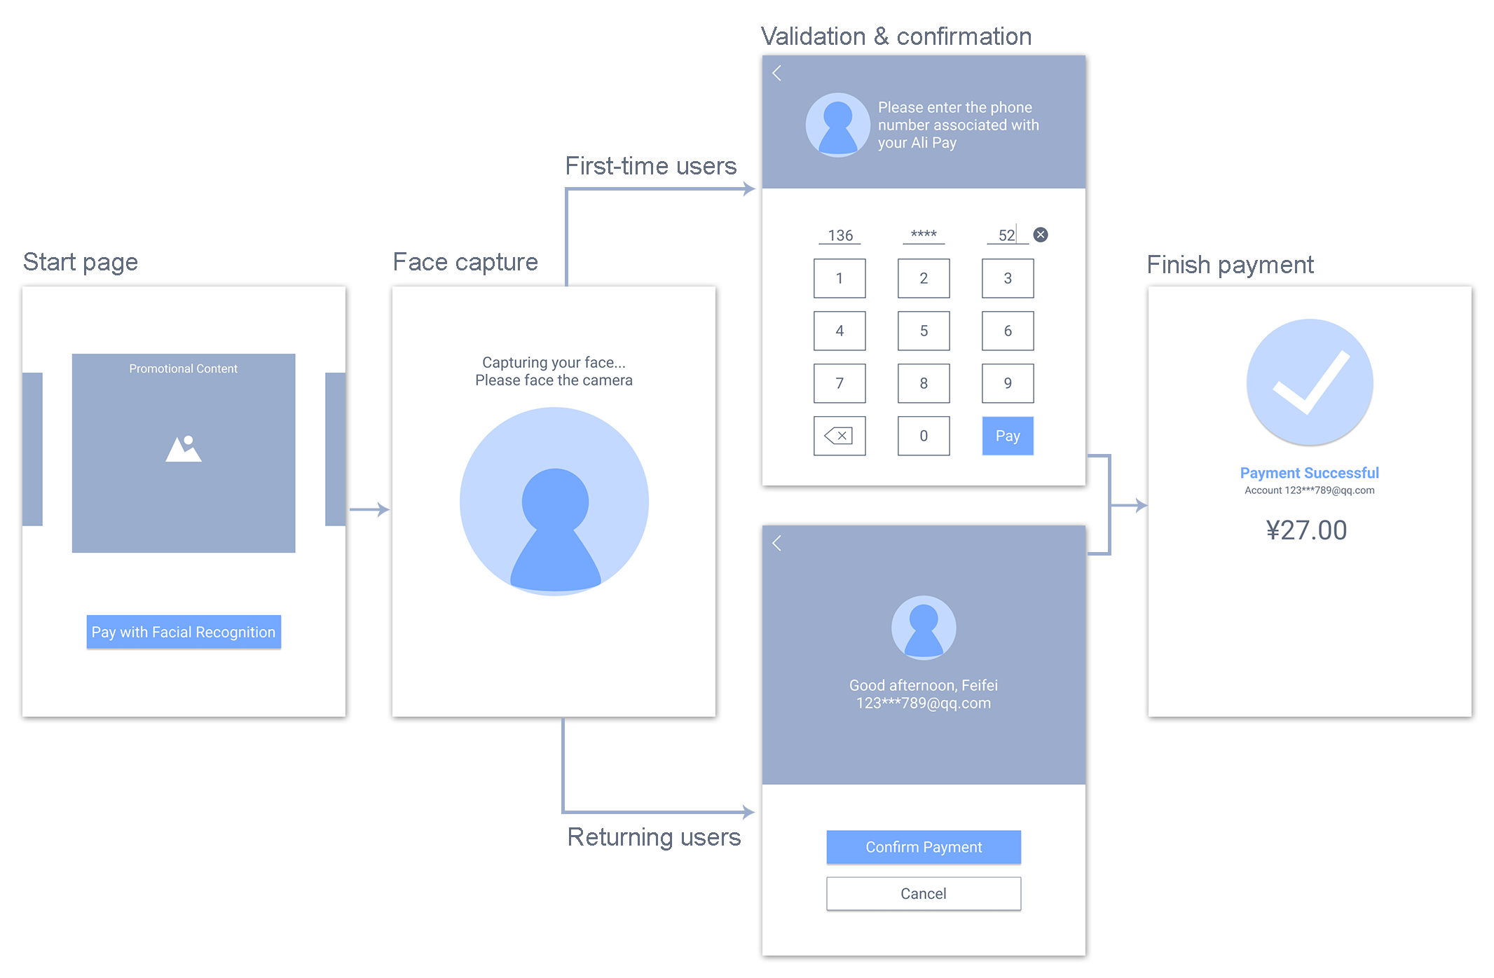
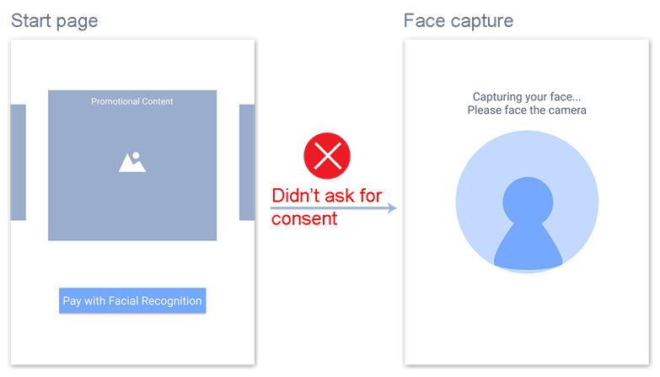

Slide 14
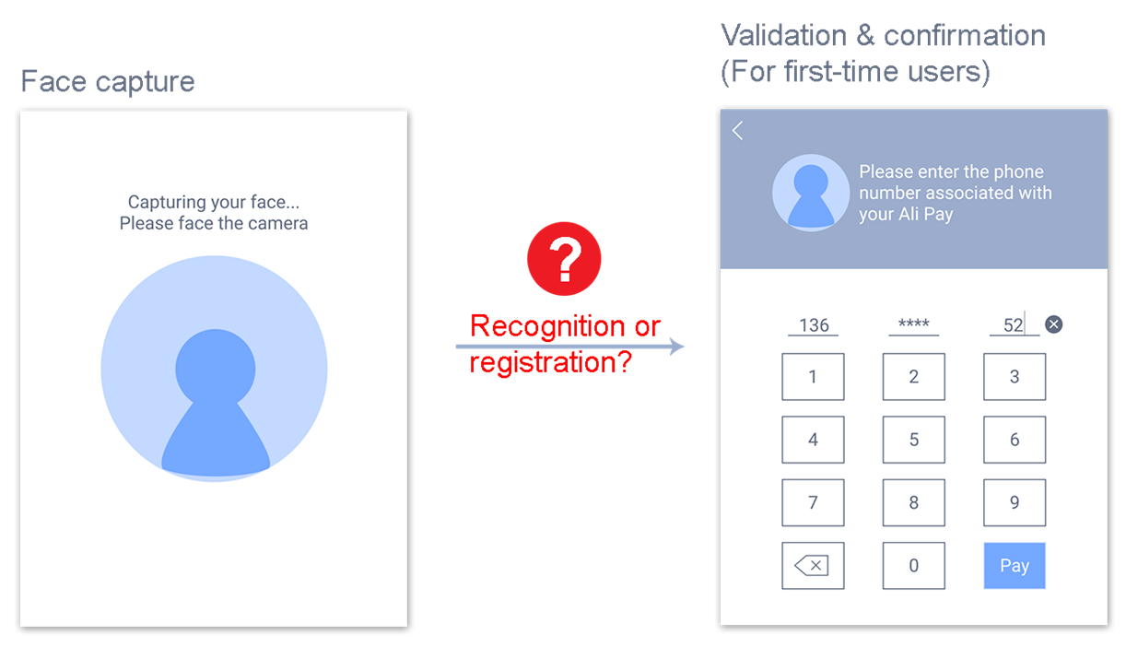
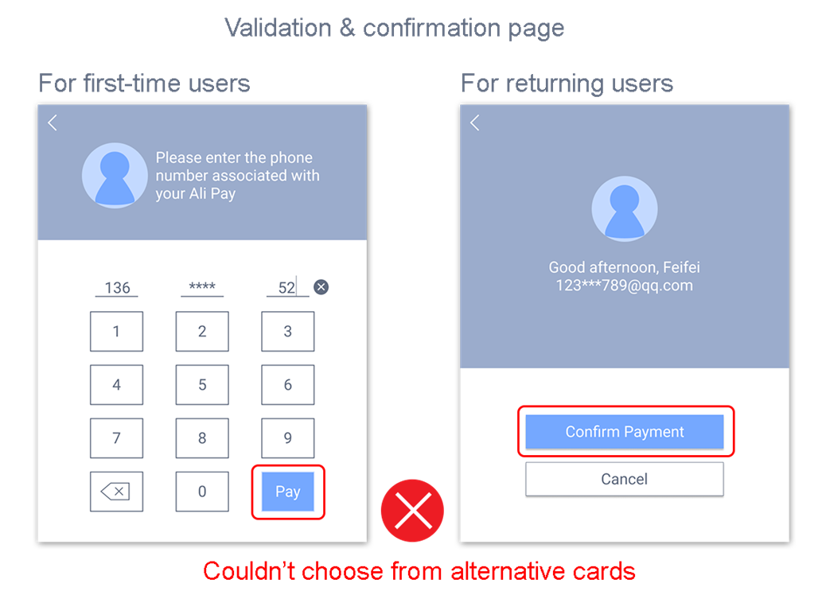

Slide 15
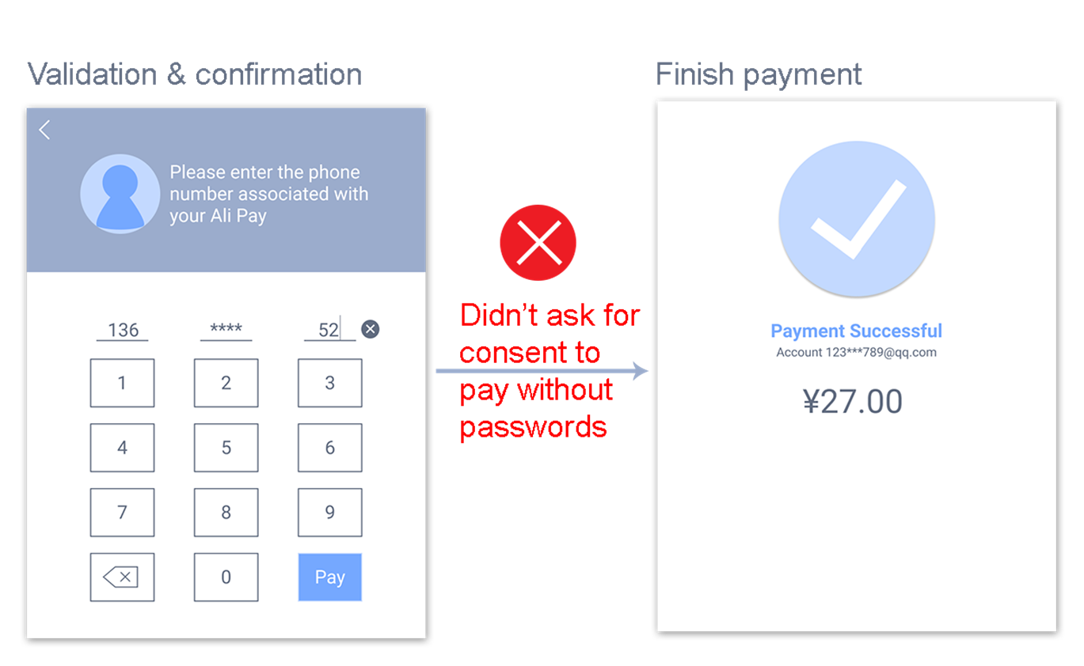

Slide 16
MISTAKES THAT SHOULD BE CORRECTED

Slide 17
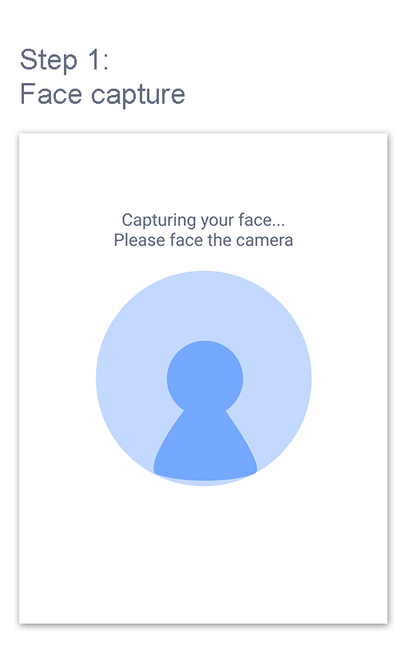
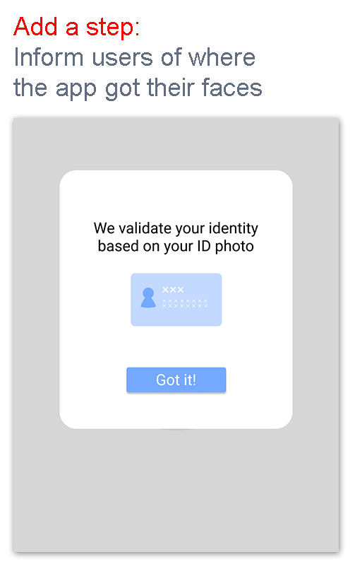

Slide 18
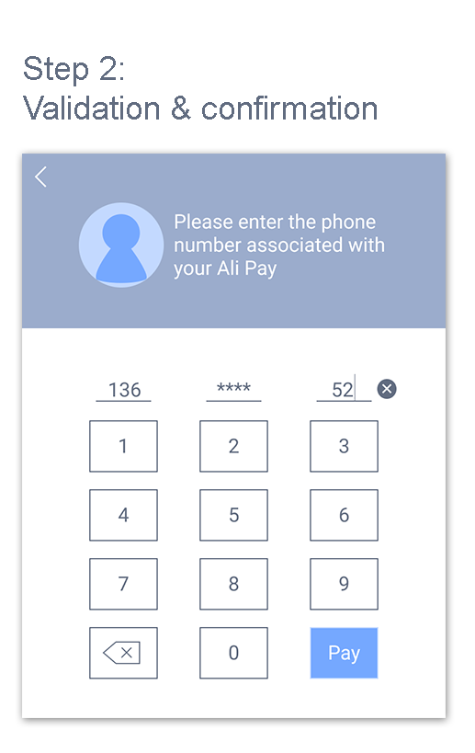
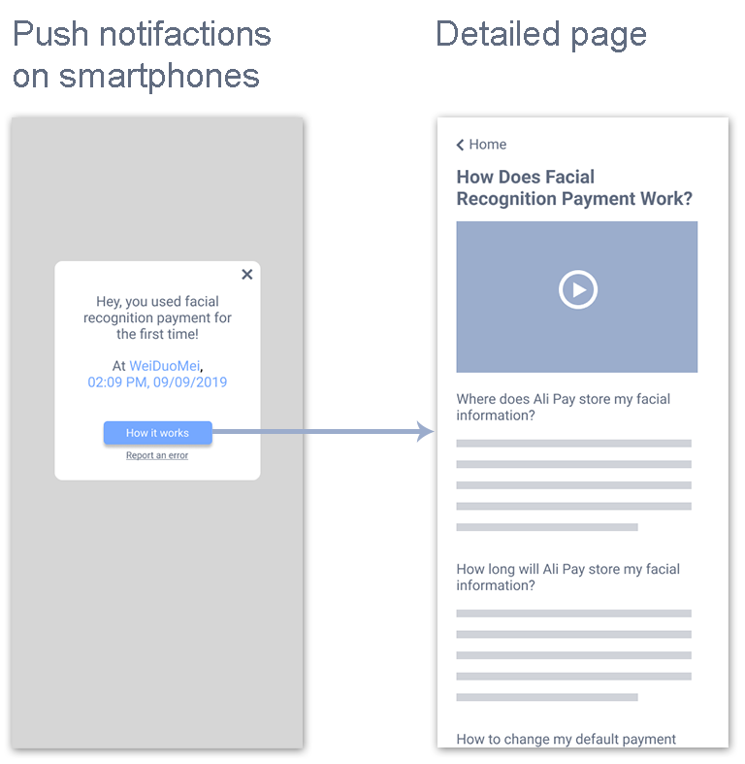

Slide 19
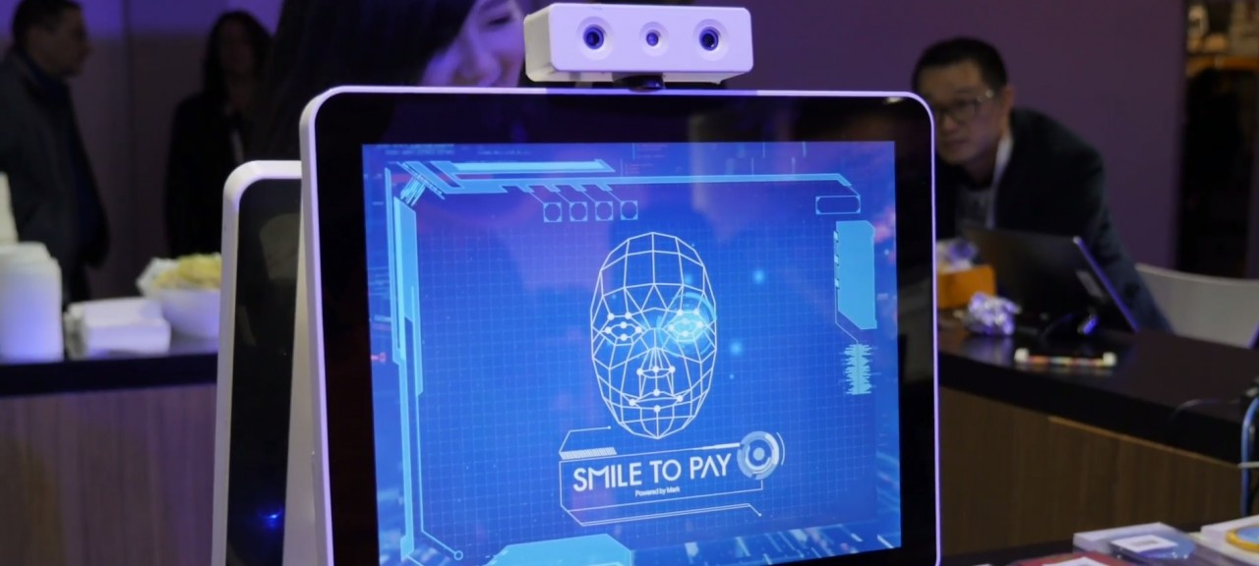
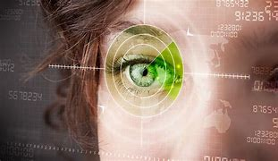

Slide 20
survey
We conducted a survey on the FACIAL PAYMENT METHOD 1. DO YOU HAVE A BANK ACCOUNT? 2. HAVE YOU BEEN TO AN ATM? 3. HAVE YOU WITHDRAWN MONEY? 4. HOW MUCH TIME DID IT TAKE YOU TO COMPLETE THE WITHDRAWAL? 5. HAVE U HEARD OF FACE WITHDRAWAL METHODS? 6. IF IT COMES IN USE WILL YOU USE IT? 7. WILL YOU ENCOURAGE FACE PAYMENT METHODS? 8. WILL YOU FEEL IT SAFER? 9. DO YOU THINK ITS COMFORTABLE AND A EASIER METHOD OF WITHDRAWING MONEY? 10. WHAT DO YOU THINK ABOUT FACE PAYMENT METHODS?

Slide 21
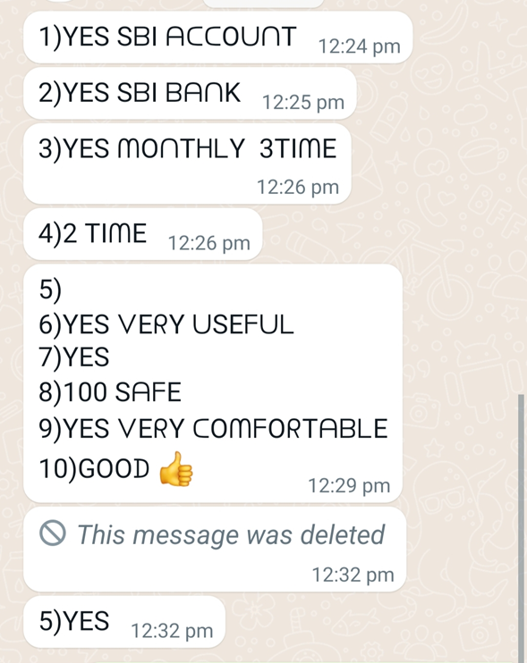
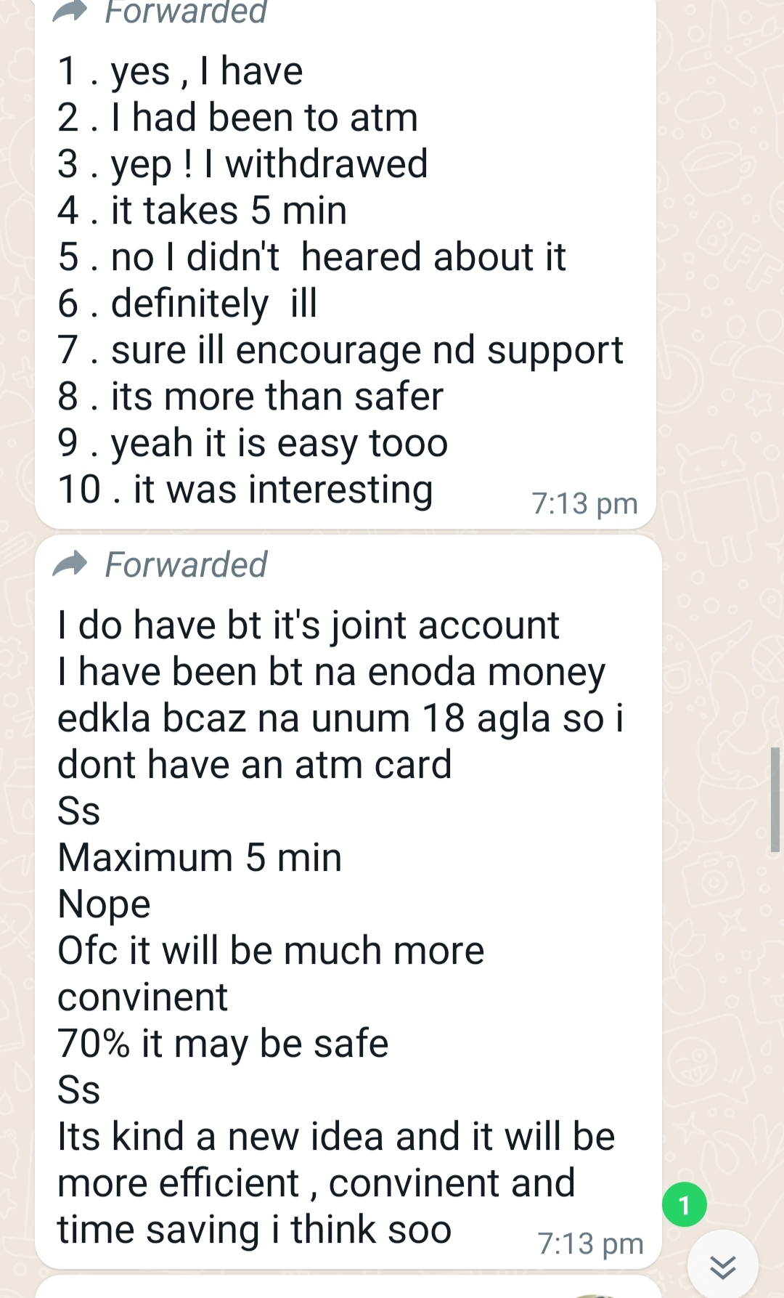
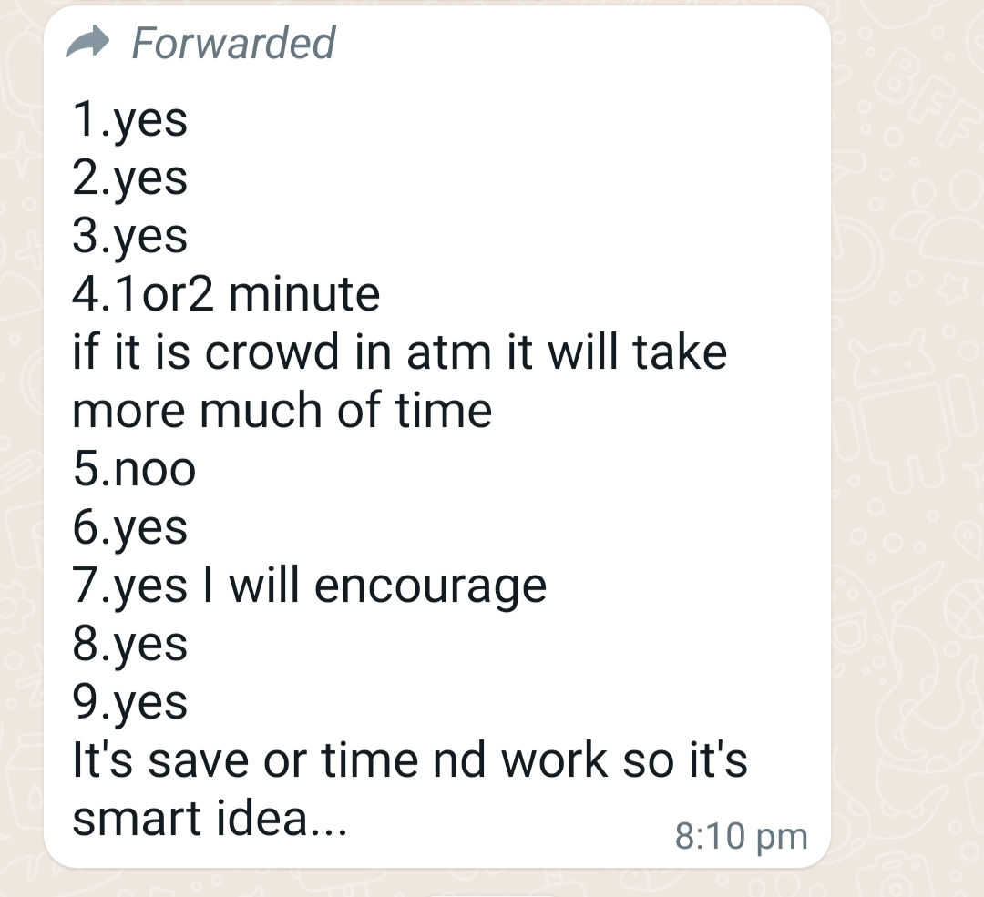

Slide 22
BENEFITS OF FACIAL PAYMENT
First, it’s more secure when compared with other payment methods.
Credit card numbers, account passwords and PINs can be stolen or hacked, leading to identity theft and loss of funds. Facial recognition payment requires the presence of a real user in order to grant access.
It’s also more convenient. You don’t have to worry about reaching the checkout only to realize you’ve left your wallet or phone at home. All you need is your face – and it’s always with you

Slide 23
conclusion
In conclusion, facial recognition payments are more frictionless than current mobile payment systems, primarily because no device is needed to complete the transaction. The technology not only eliminates the need for smartphones, it also provides more convenience, offering consumers another way to make payments.

Slide 24



Slide 25



Slide 26


Slide 27
THANK YOU

